Slide 1
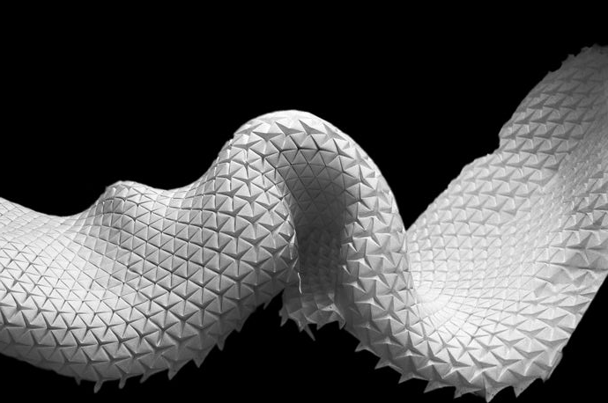
Assistive Technology for Adults with ASD
IDM Thesis Project by Caitlin Sikora

Slide 2
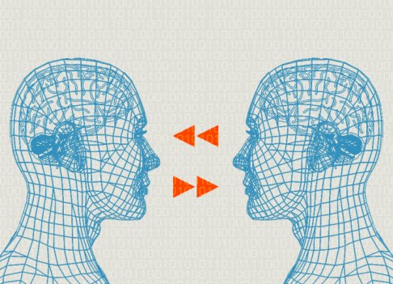
Empathy & Communication

Slide 3
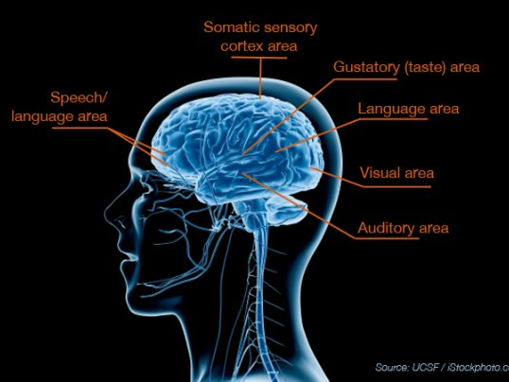
Sensory Processing

Slide 4
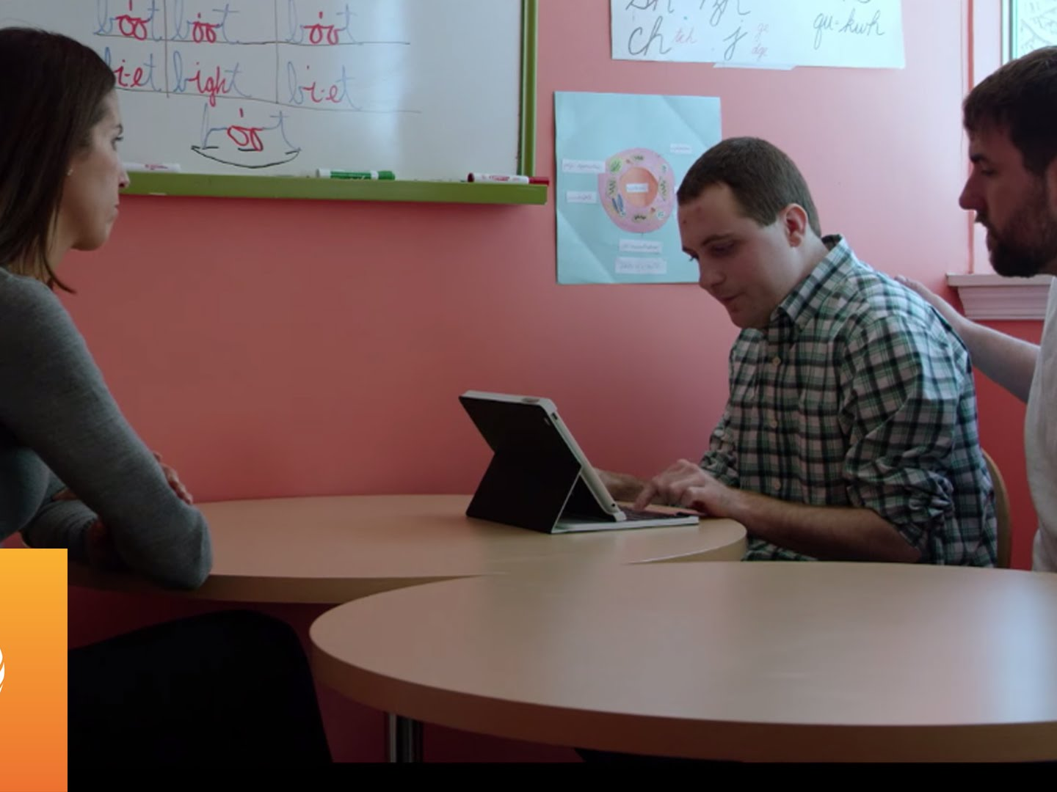
Personal Accounts

Slide 5
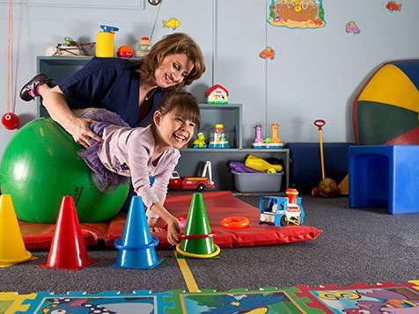
Existing Therapies
& Technologies

Slide 6

Holistic Approaches
Solidify Social Interactions
Body as Multi-Directional
Medium for Communication

Slide 7
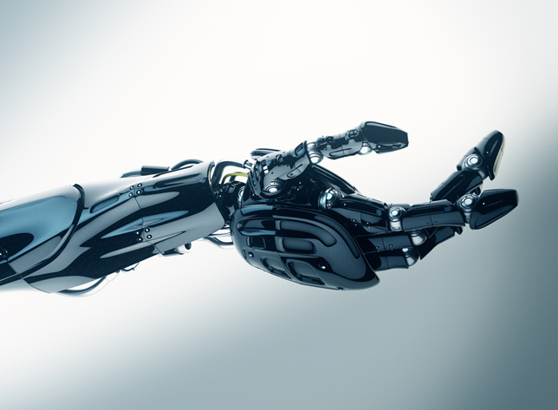
Cures & Therapies

Slide 8
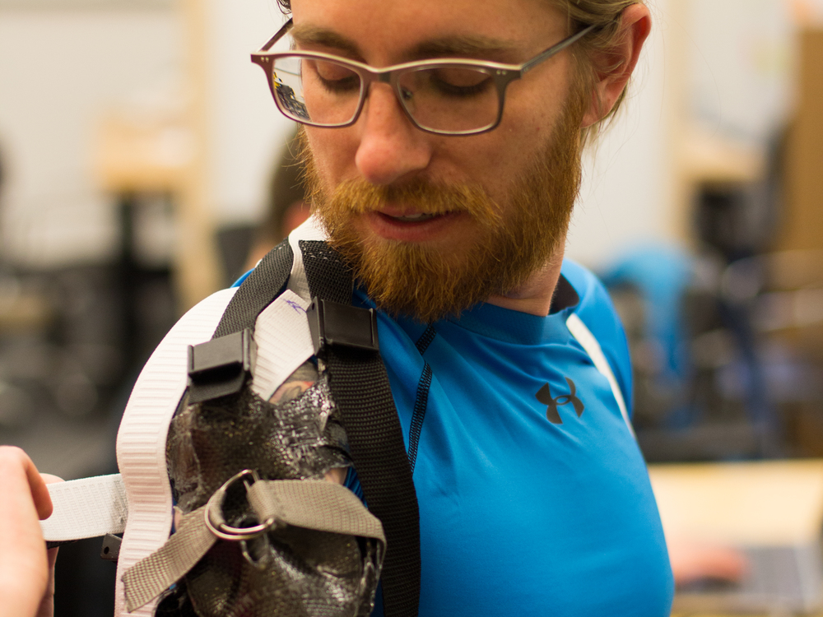
Adaptive
Tech

Slide 9
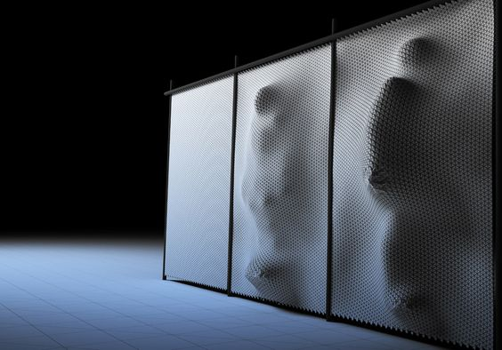
Fluid vs. Solid
What is
ASSISTANCE?
What is an
ABLE BODY?

Slide 10
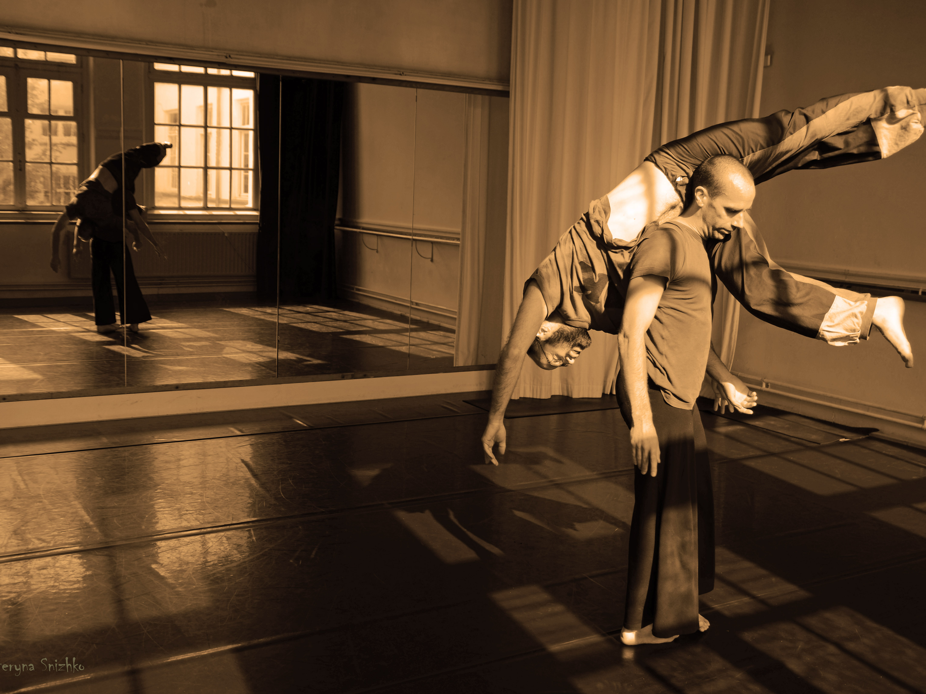
Responsive & Fluid

Slide 11
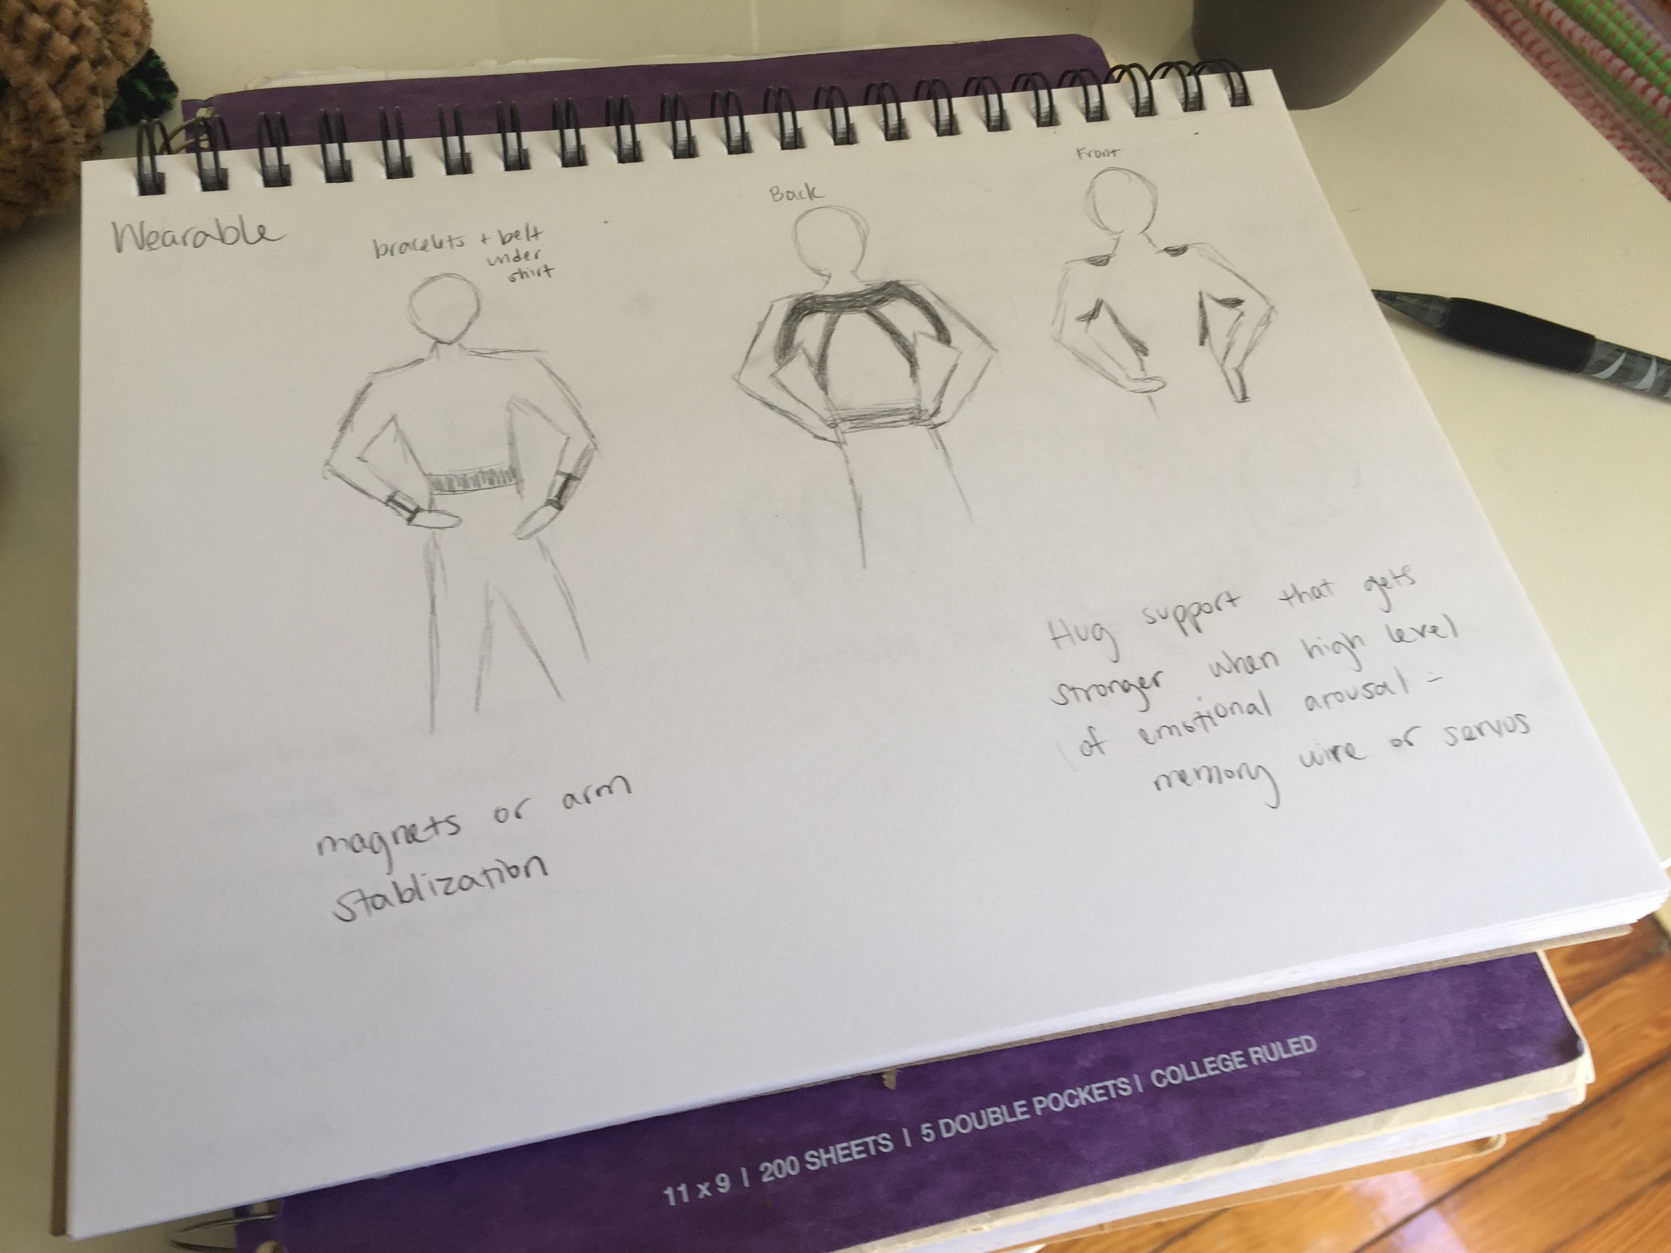
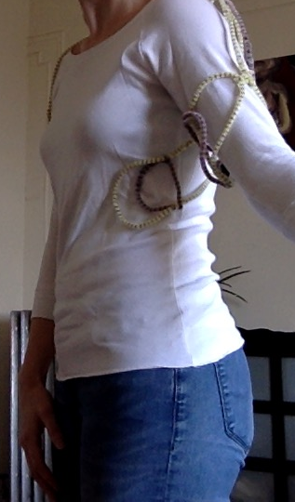
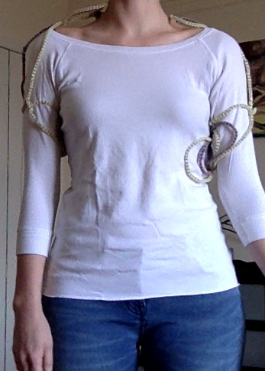
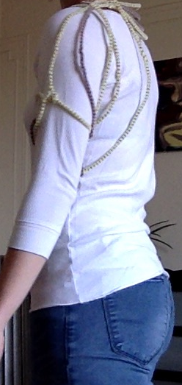
Wearable Prototyping

Slide 12
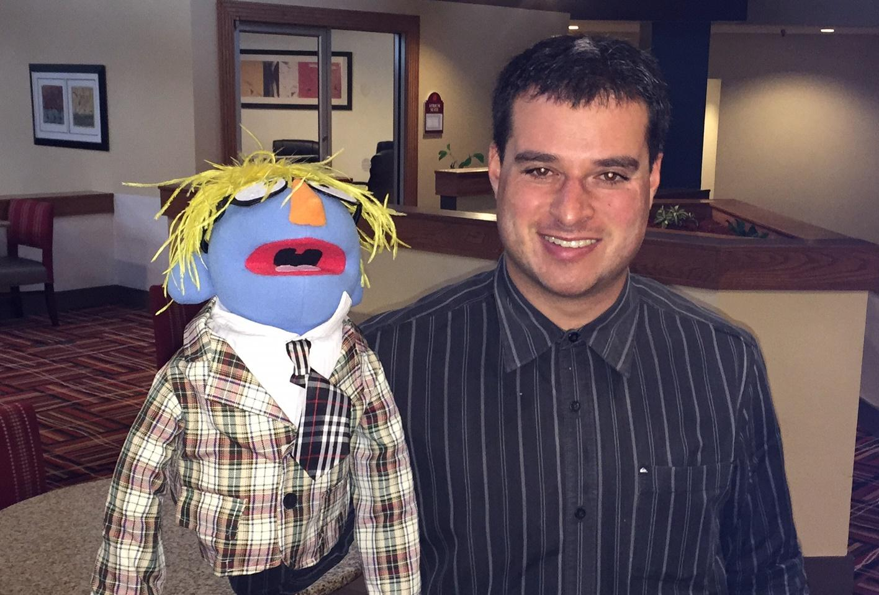
Hangin’ with
Jesse Saperstein

Slide 13
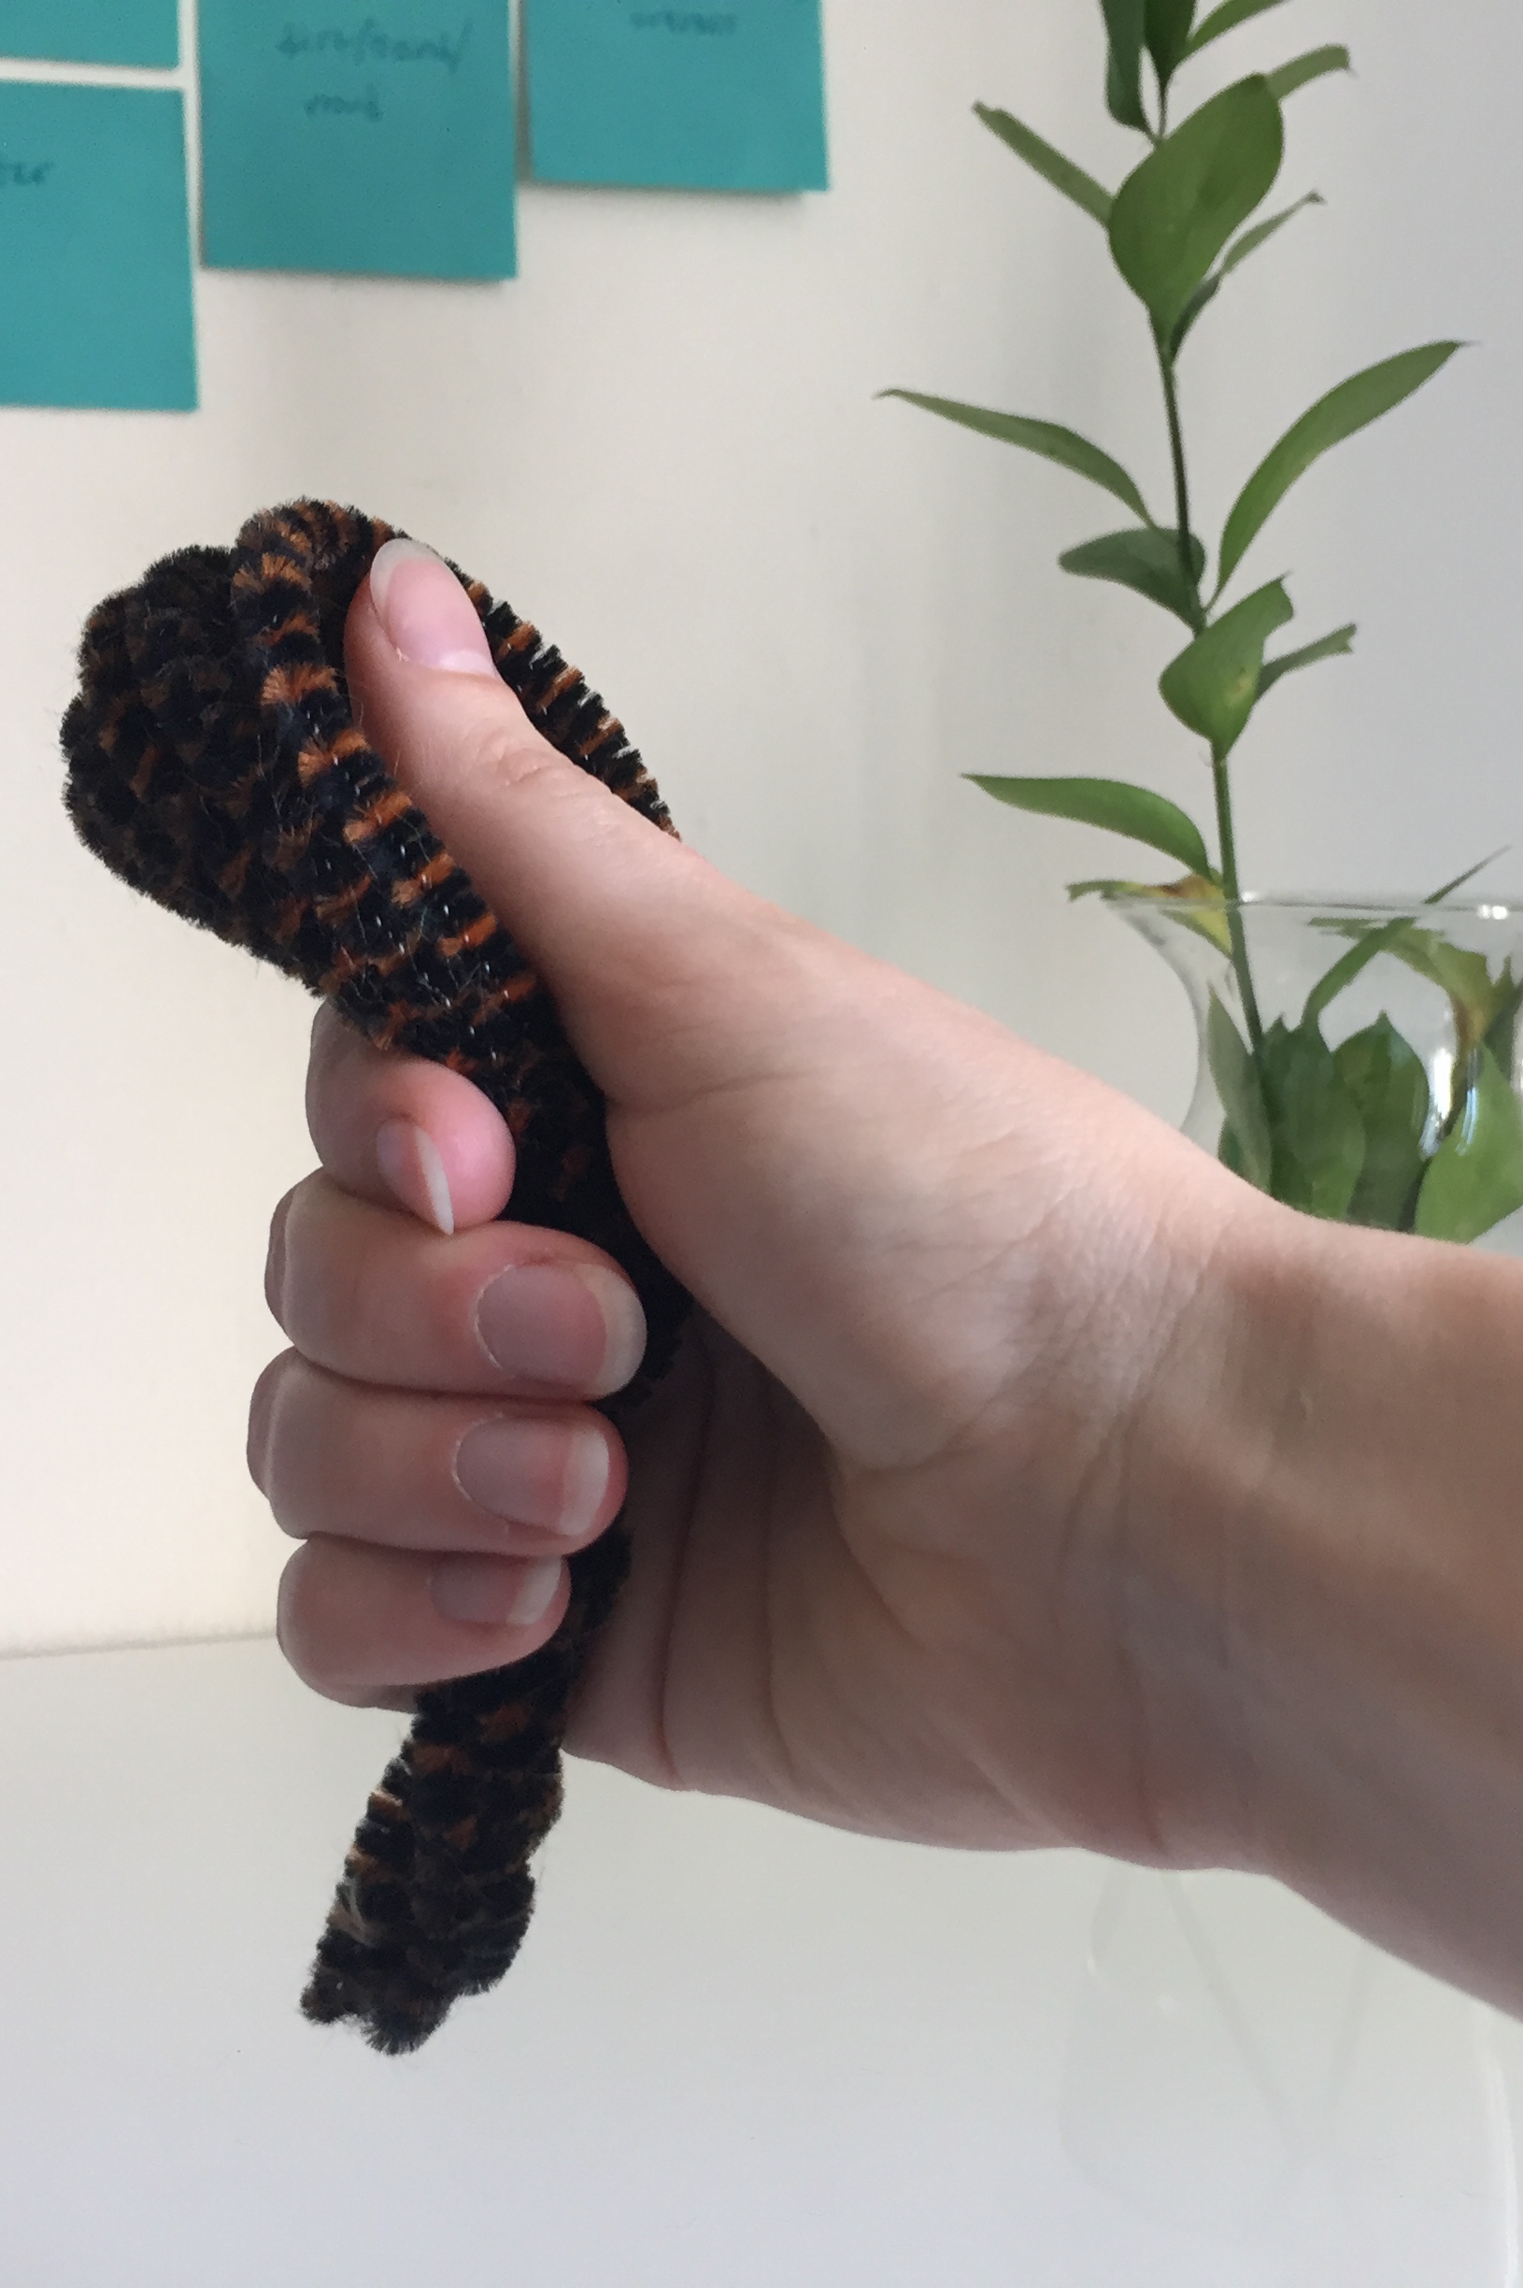
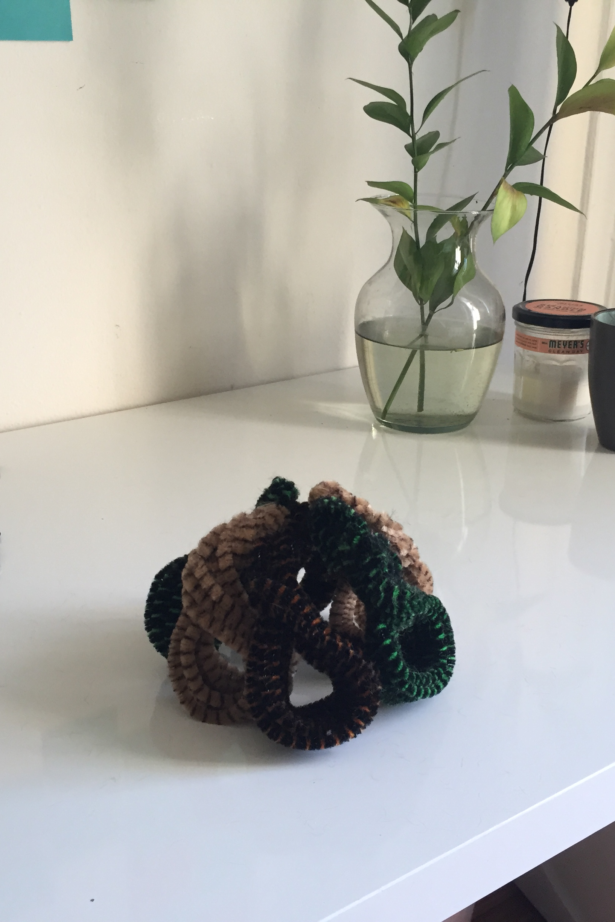
Game Prototyping

Slide 14

Building Position from Acceleration

